Slide 1

Comparing Flora Flowering Data between iNaturalist and Historic Databases
Dr. Daijiang Li
BIOL4800
Evelin Reyes

Slide 2



Introduction
Do flowering times differ between historic datasets and the iNaturalist dataset?
Are these changes in flowering time tied to changes in climate patterns?

Slide 3
Materials and Methods
Data supplied by Dr. Daijiang Li
iNaturalist
Historic data set
All data processed in RStudio
t-test
Linear Mixed Effect Model

Slide 4
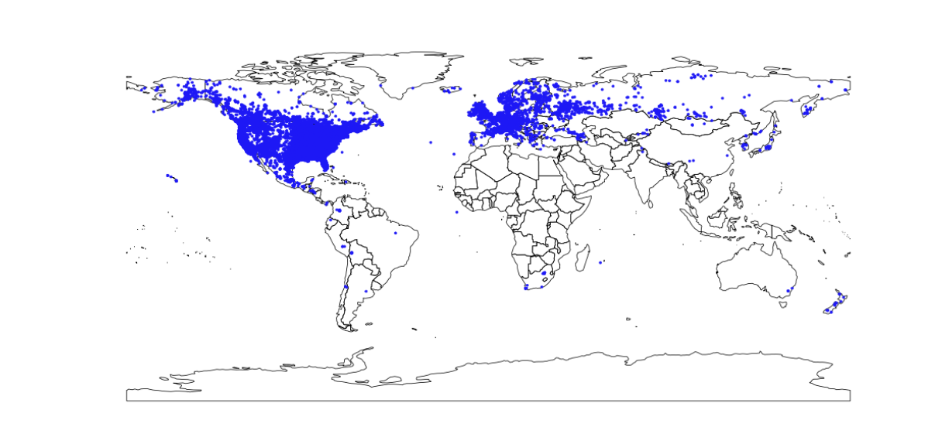
Geographic Distribution

Slide 5
Heat Map

Slide 6
Level of agreement between expert and iNaturalist data

Slide 7
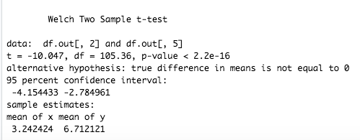
t-test

Slide 8
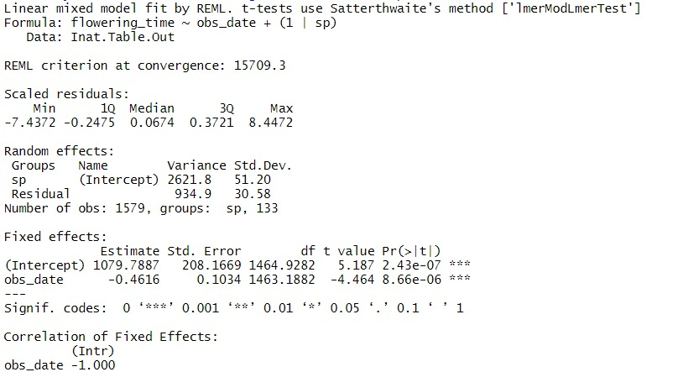
Linear Mixed Effect Model Results
For every year added the flower blooms half a day earlier

Slide 9
Conclusions
iNaturalist observes longer flowering times than experts (t-test result)
Species are flowering in average half a day earlier over the length of the study period.
Due in part to widespread geographic distribution of observations, the forces affecting increased flowering time are likely driven by changes to global climate.

Slide 10
Questions?

